Slide 1
Alerts Dashboard Admin APp
Built with Angular and Java
Configured with Maven and Jetty
Tested with Jasmine and Mockito

Slide 2
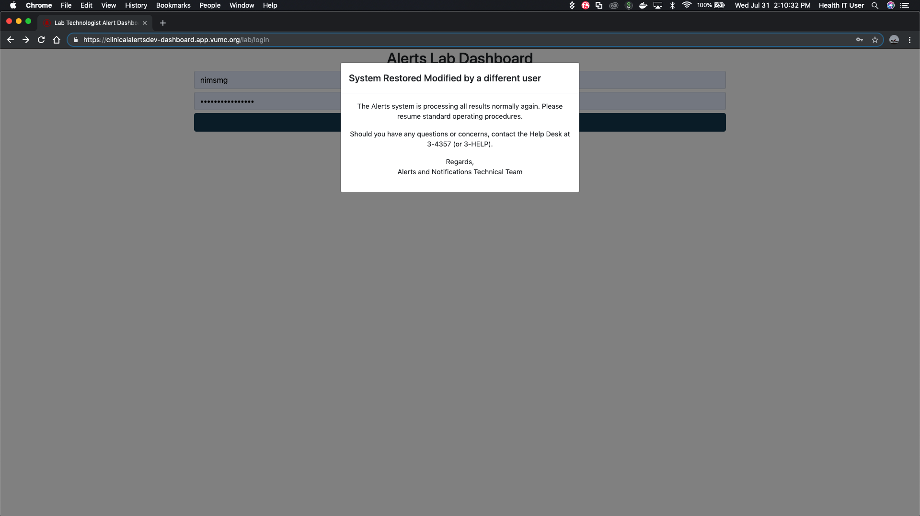
Purpose: Manage admin tasks for the Alerts Dashboard

Slide 3
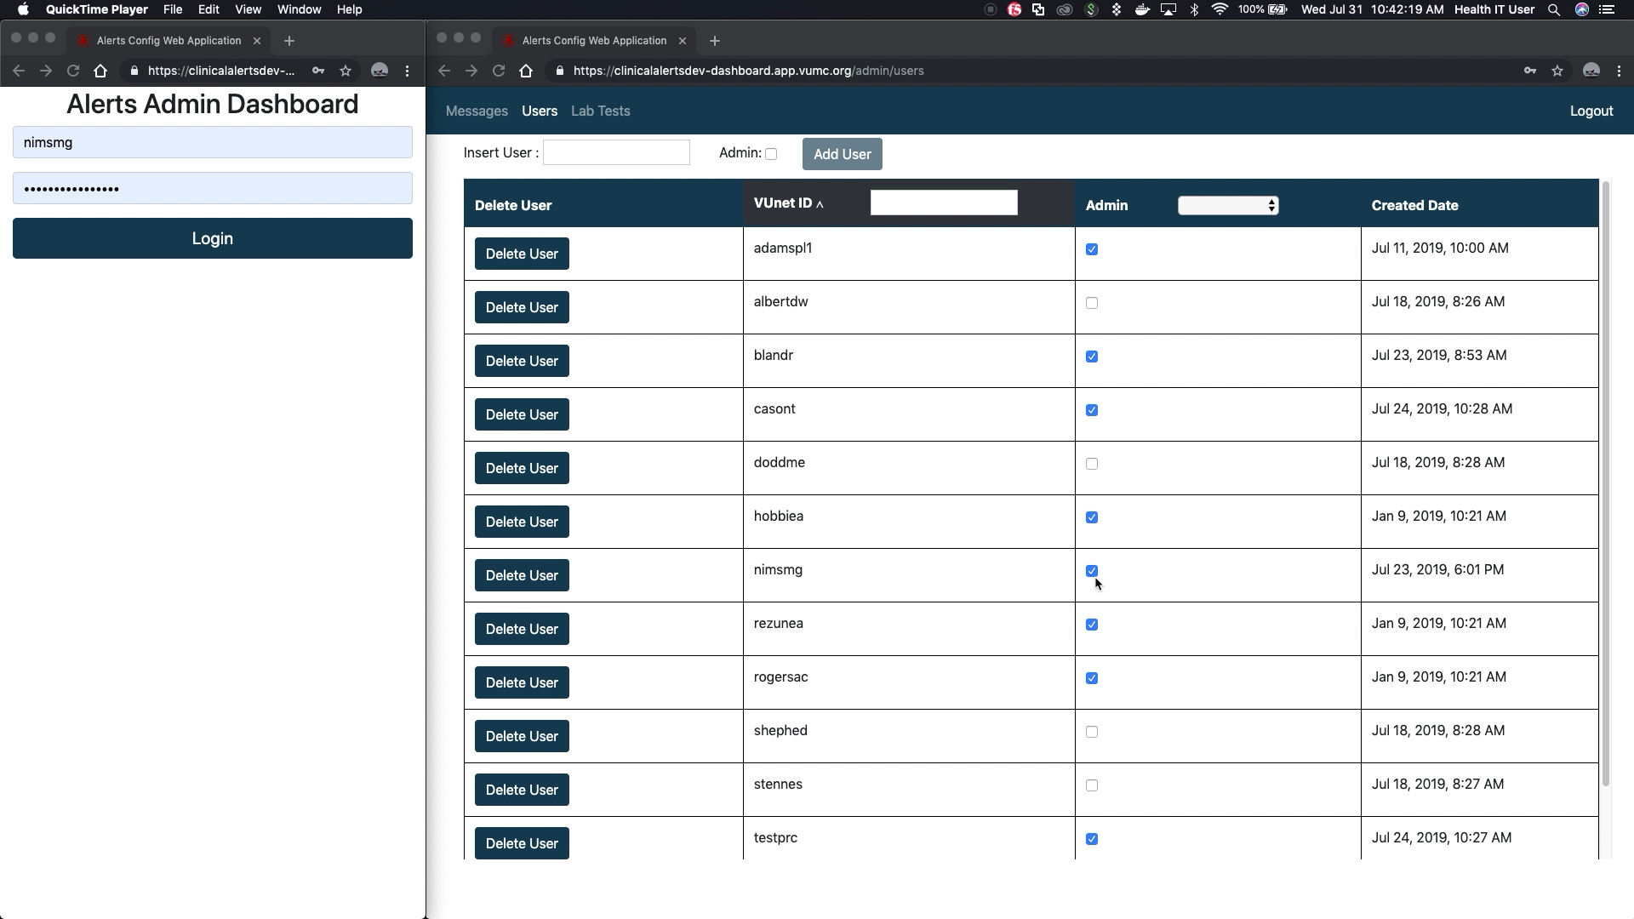
User Login Authentication

Slide 4
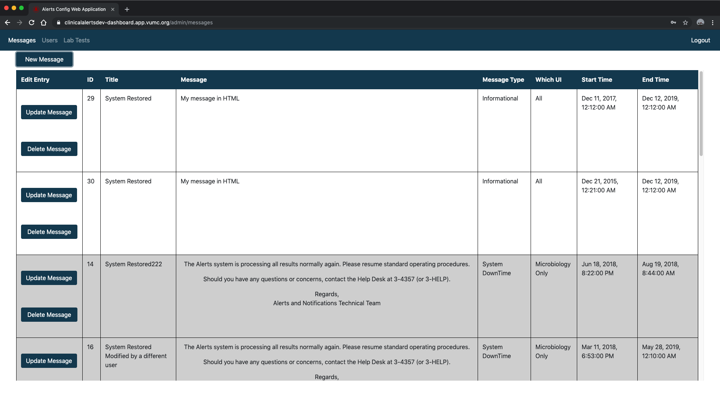
Messages sorted by activity then ID

Slide 5
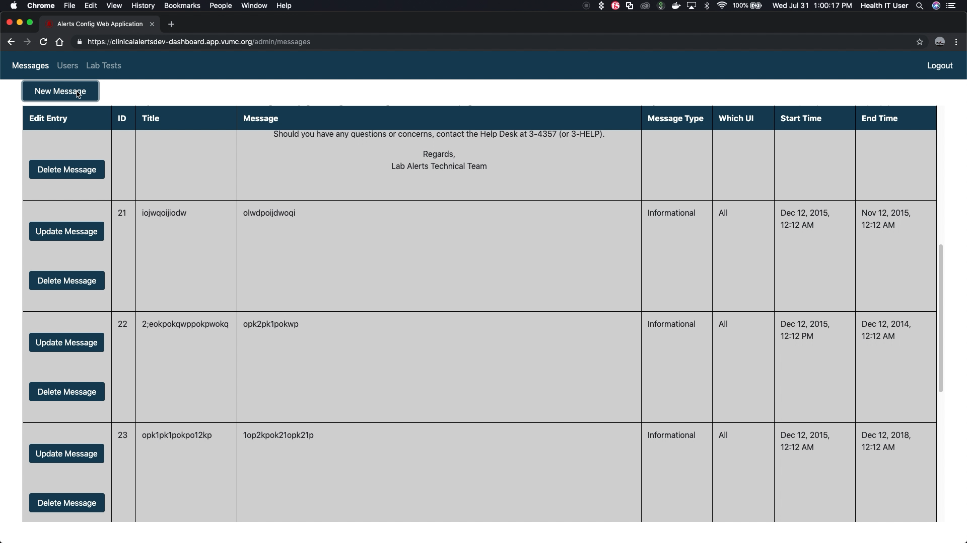
Message Form Validation

Slide 6
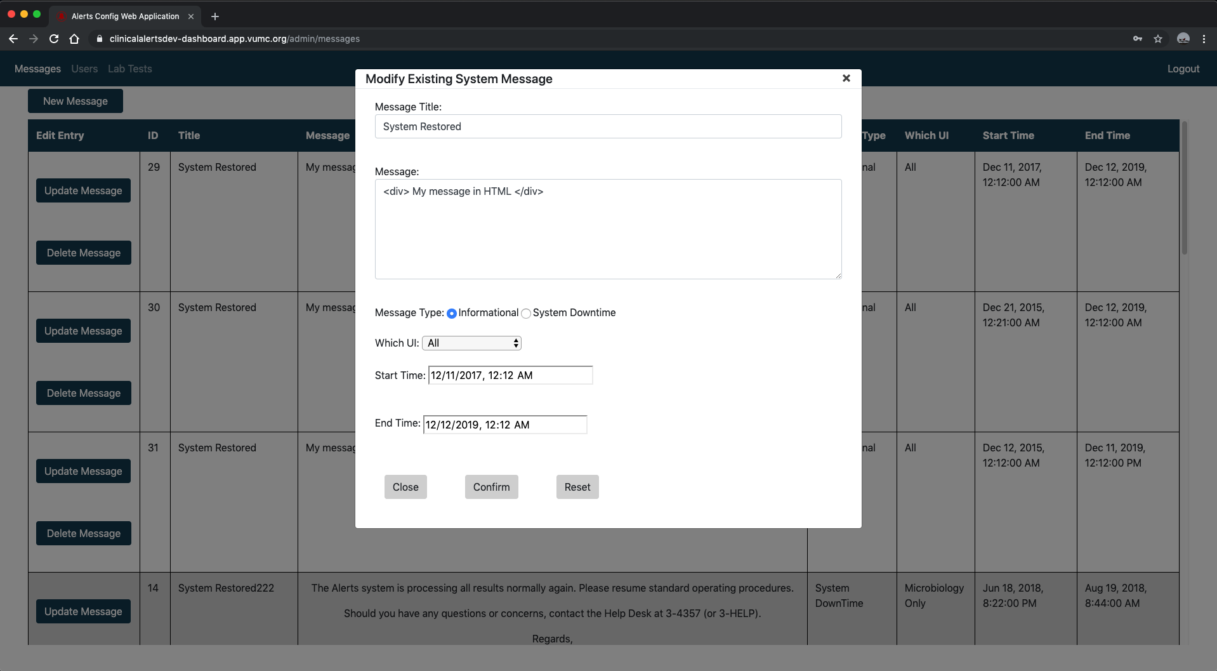
Update Message

Slide 7
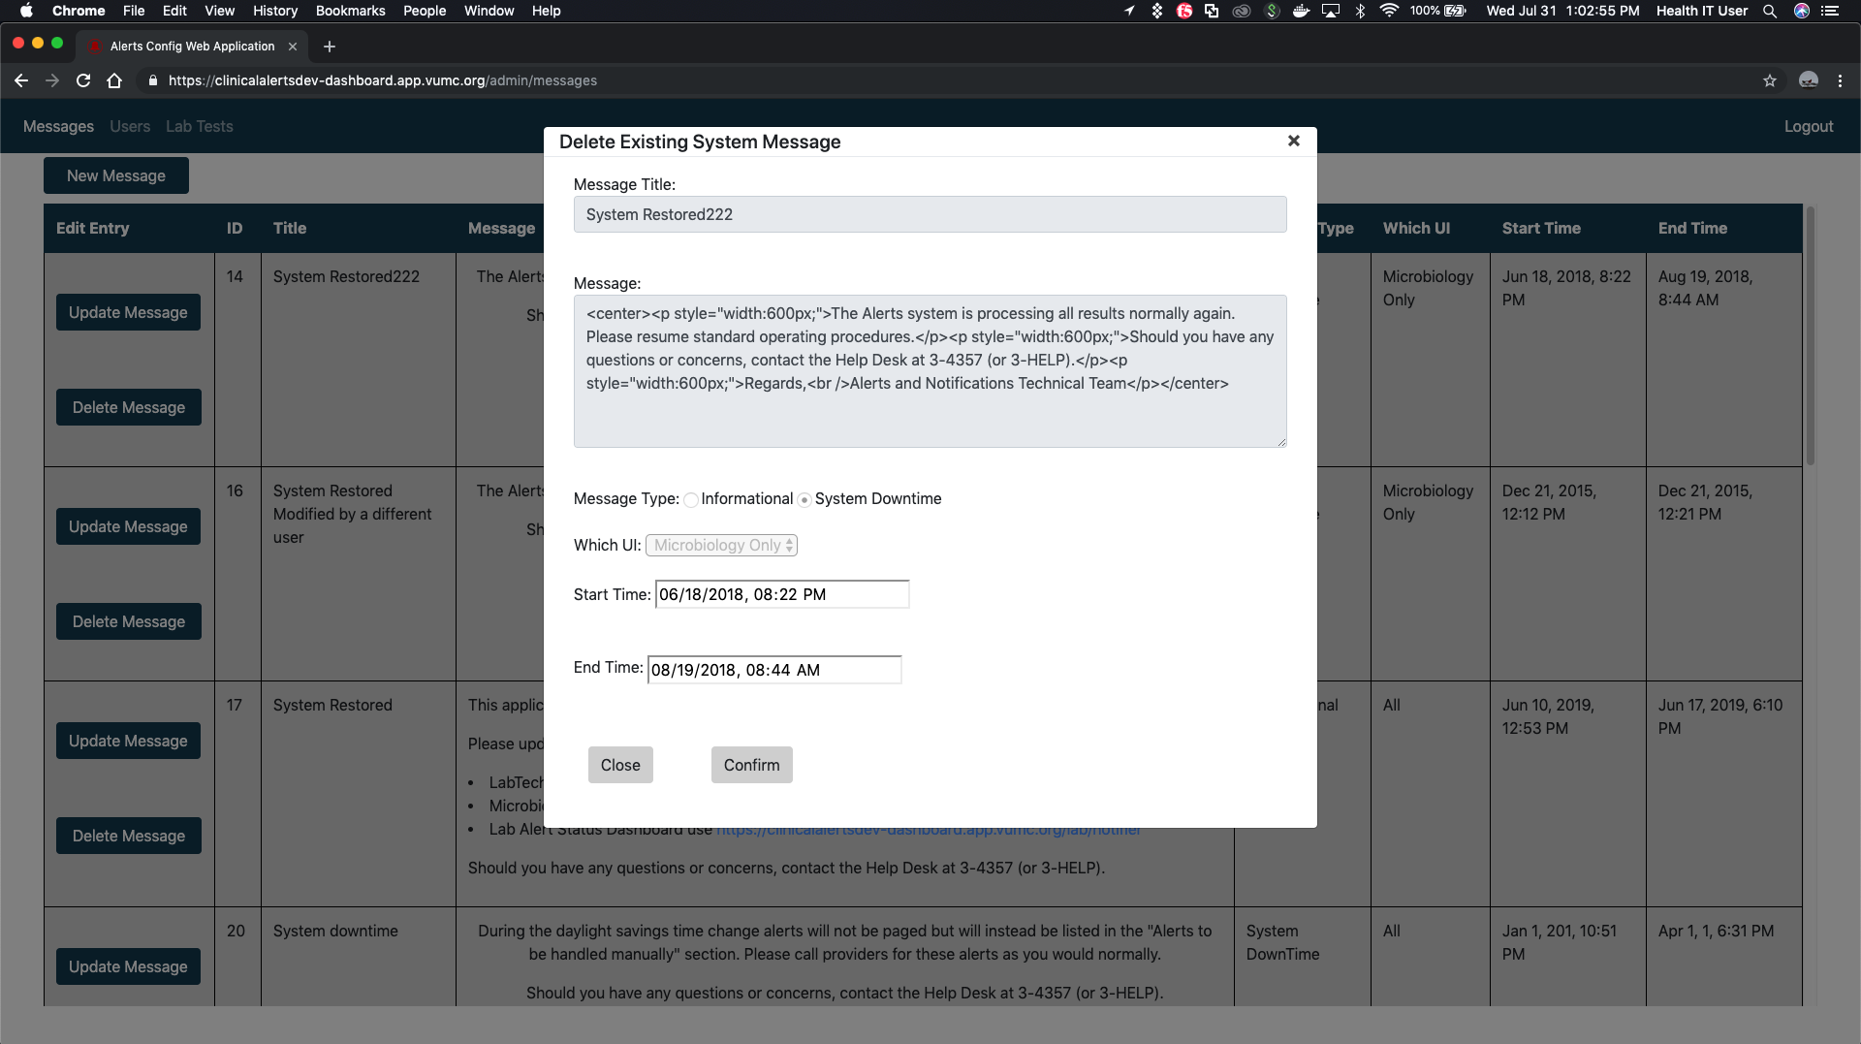
Delete Message

Slide 8
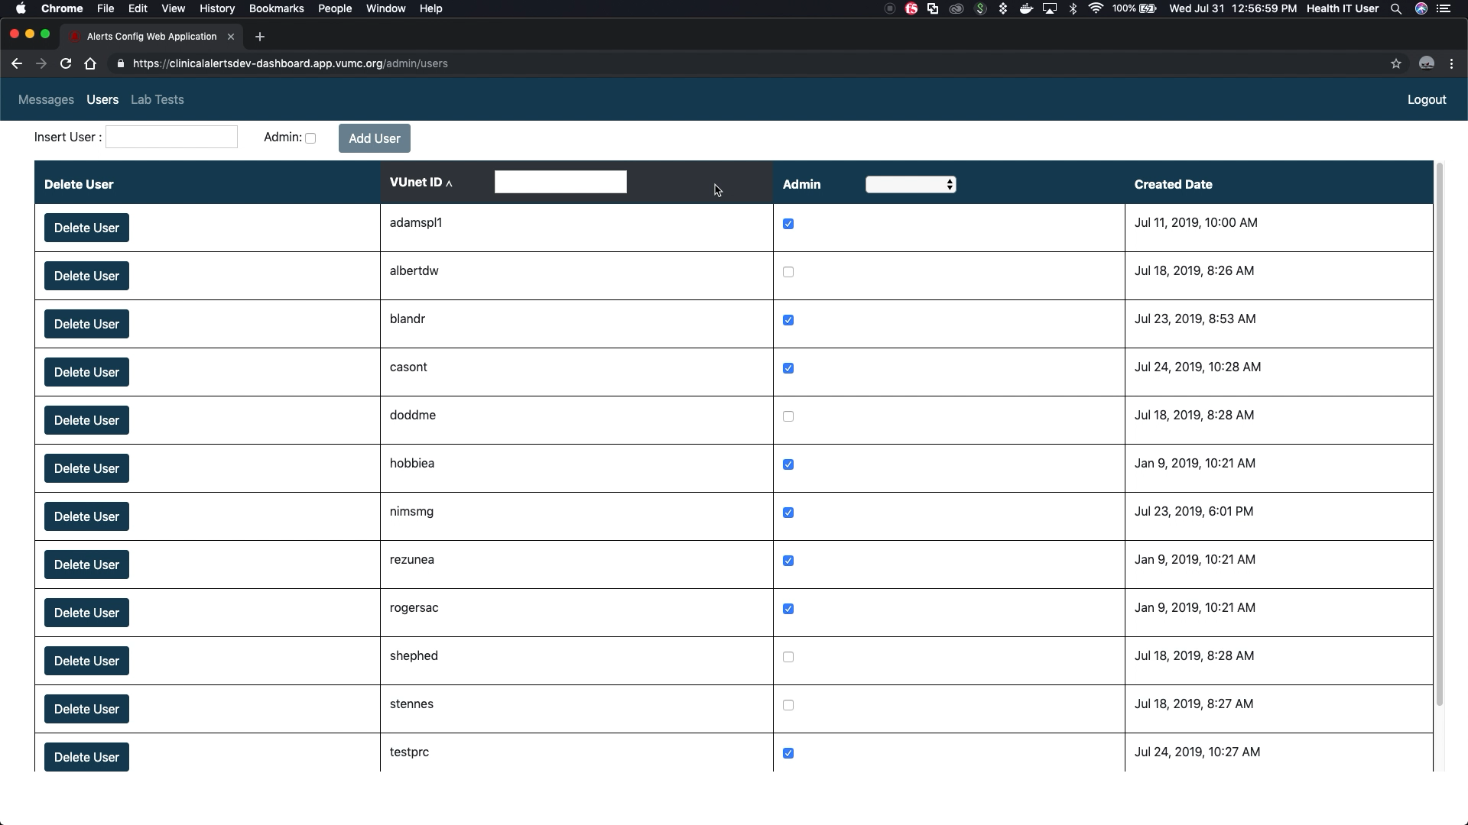
User sorting and filtering

Slide 9

Adding and Deleting users

Slide 10
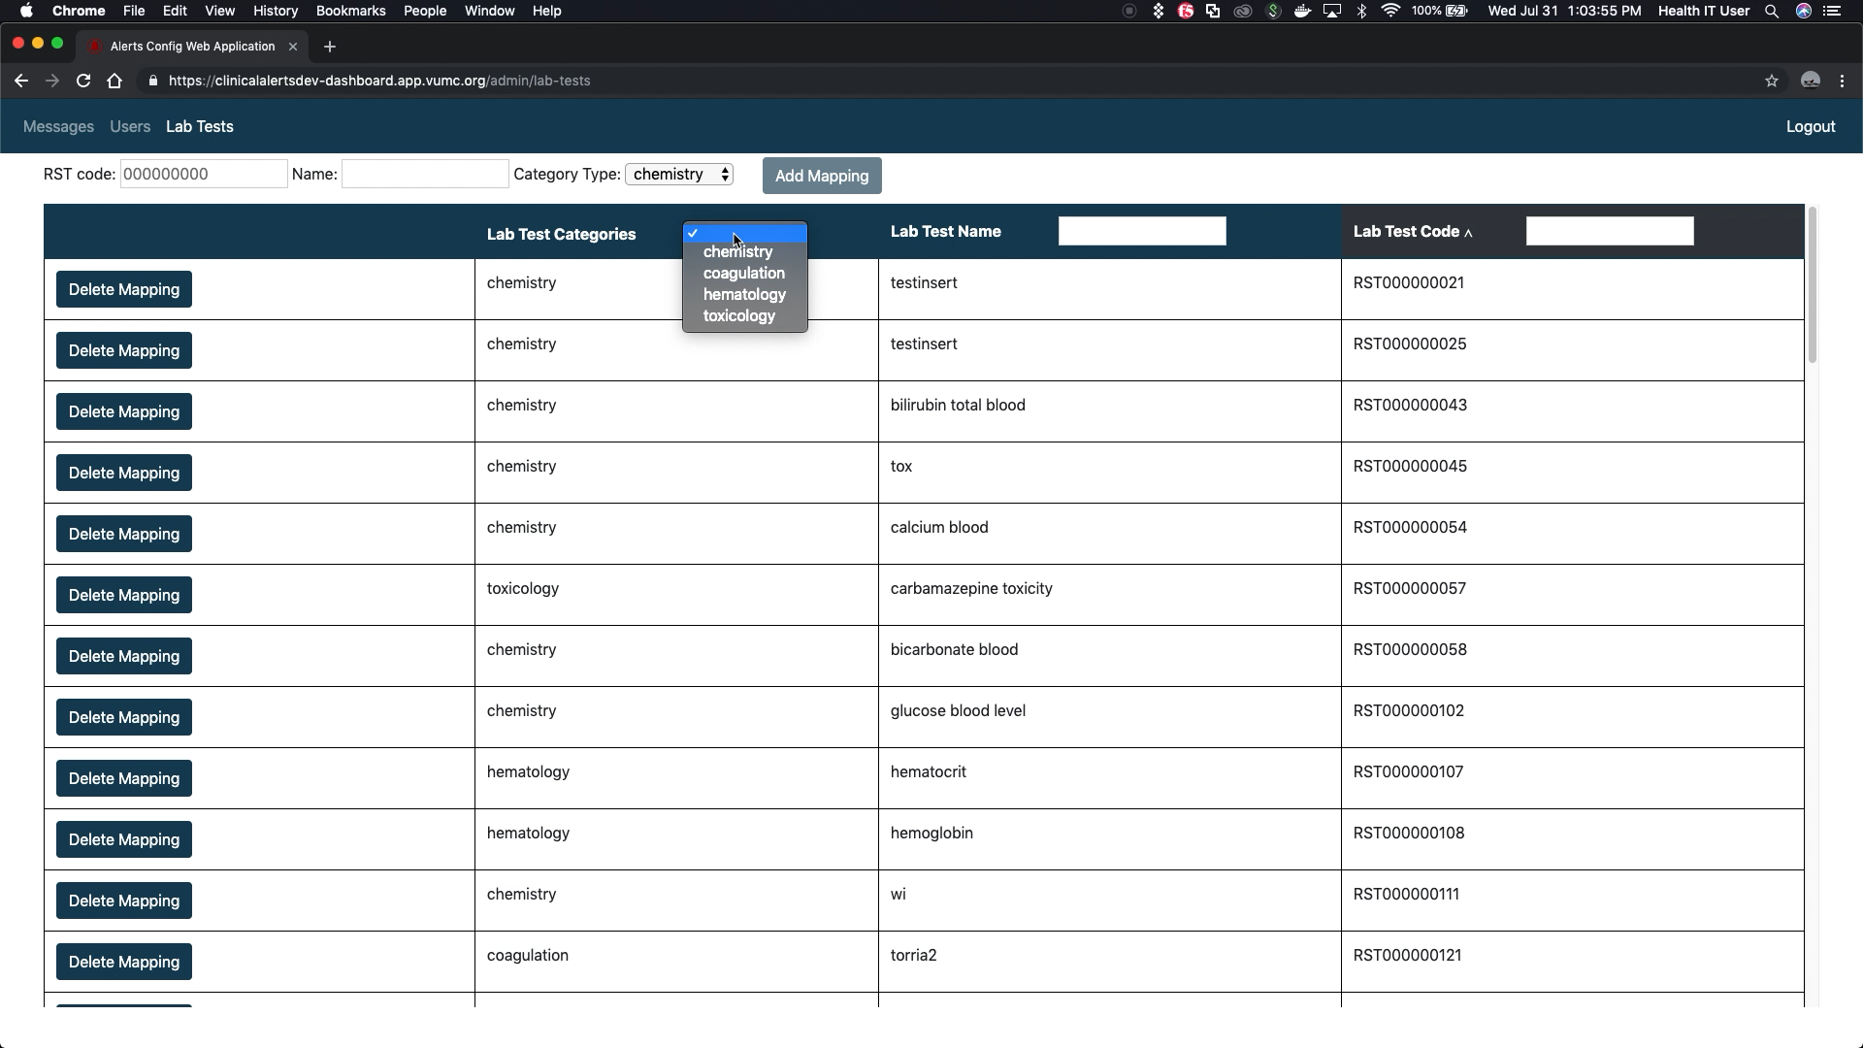
Lab Test sorting and filtering

Slide 11
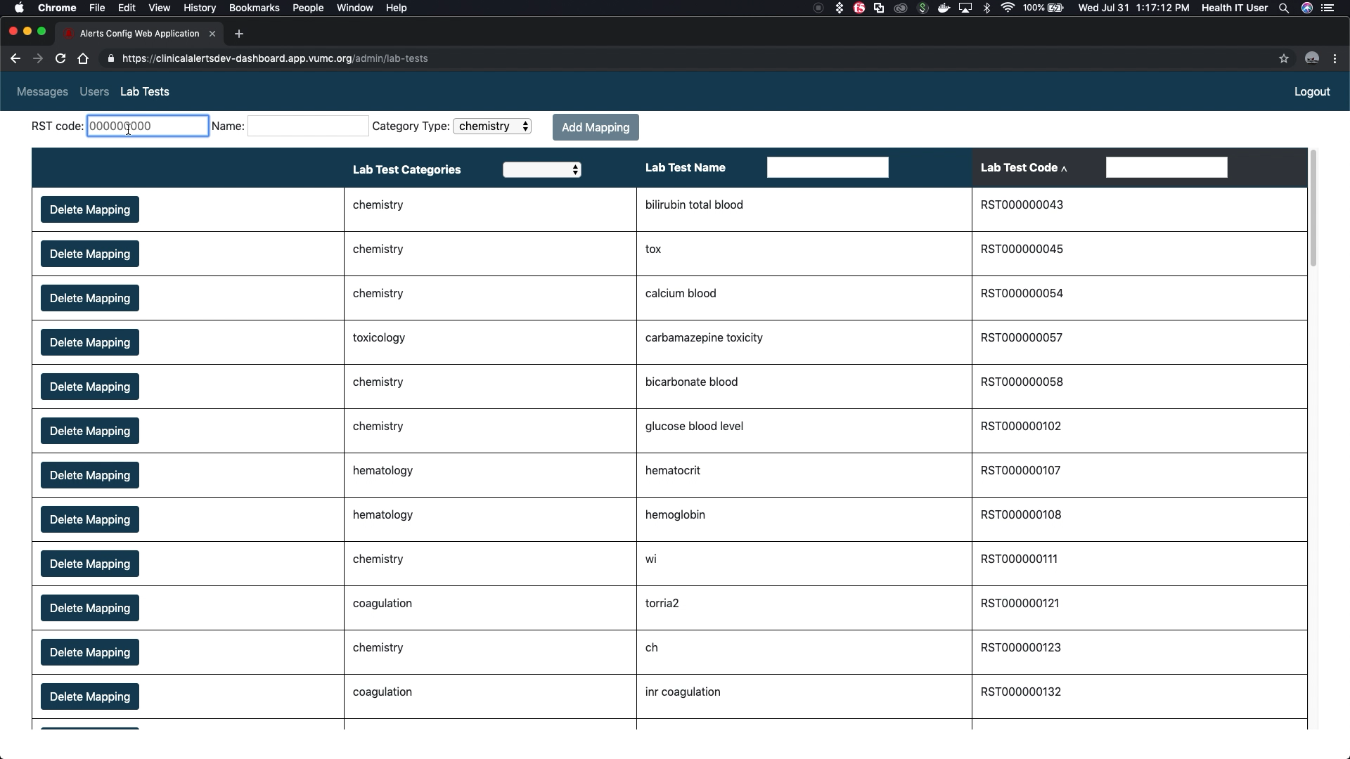
Lab test inserting and deleting

Slide 12
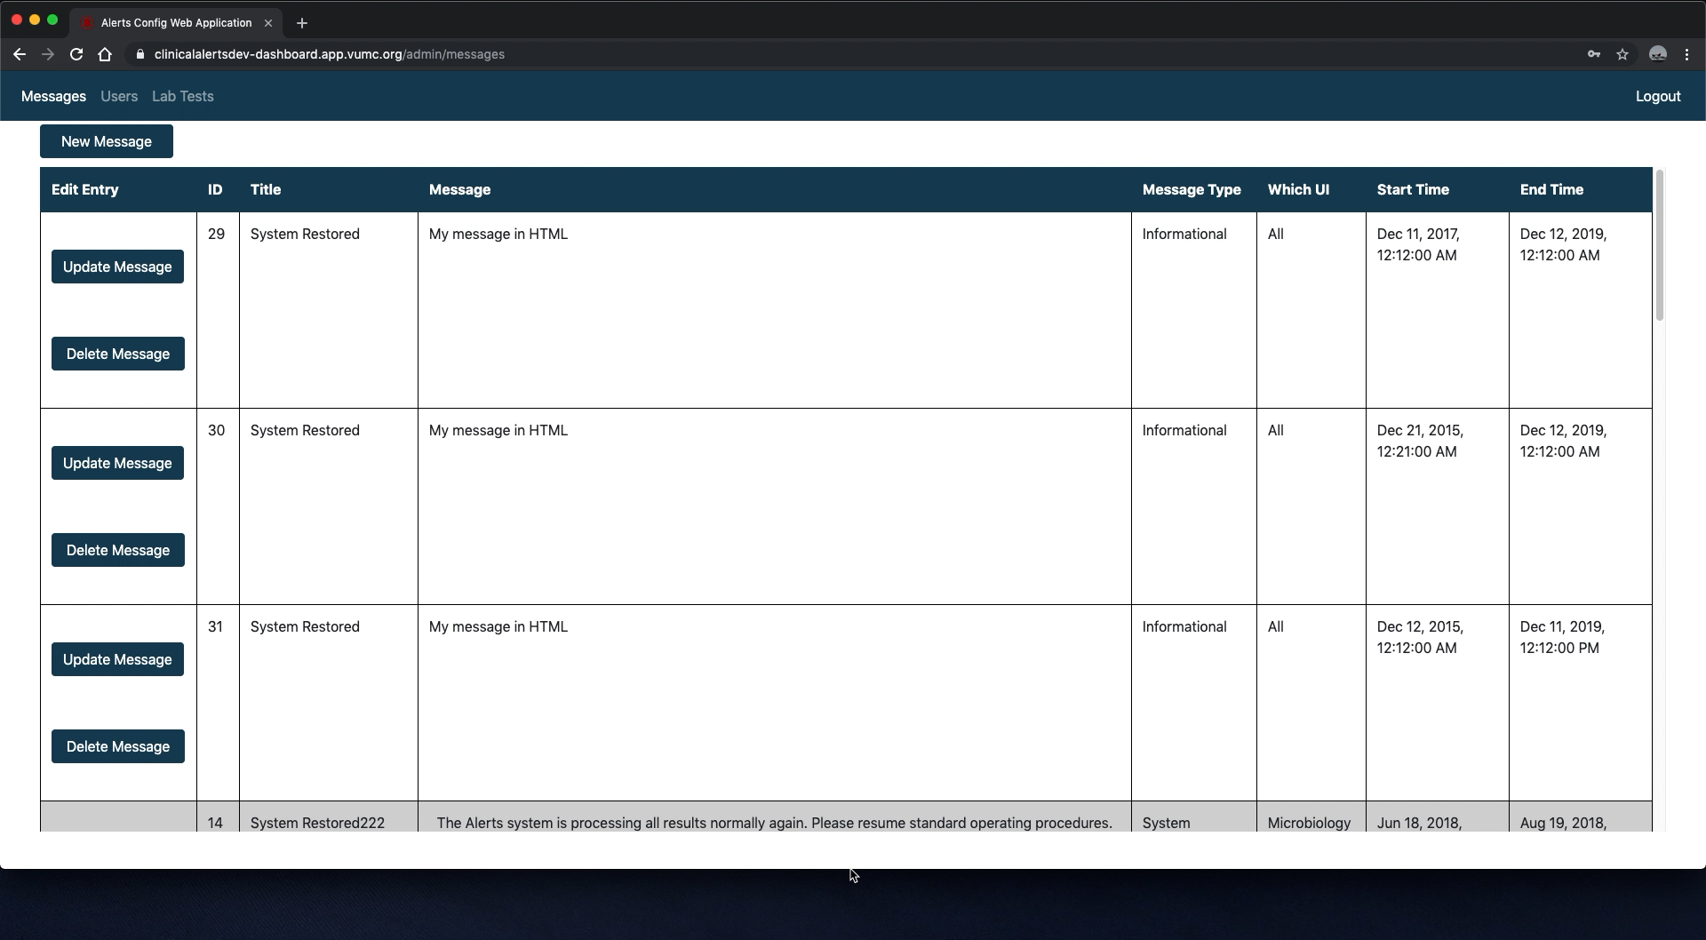
Automatic Table Scaling

Slide 13
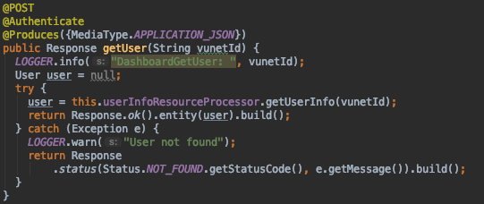
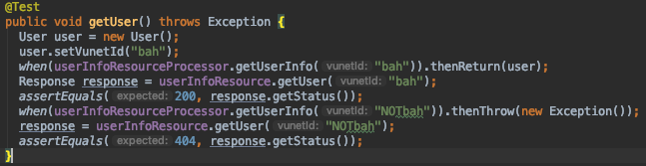
Mockito Test Example:
Validate a 404(not found) is returned when an exception is thrown.
Validate a 200(ok) is returned when user is returned.

Slide 14
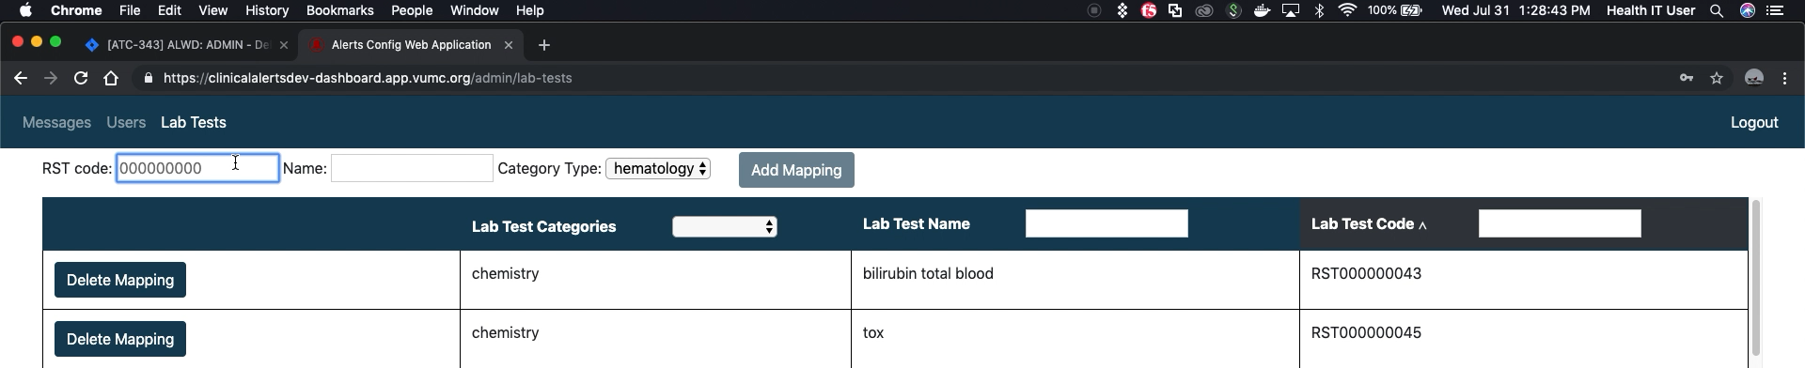
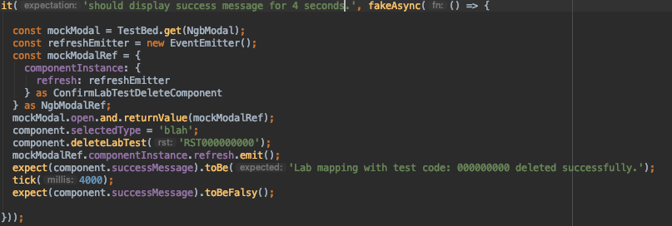
UI Jasmine Test example:

Slide 15
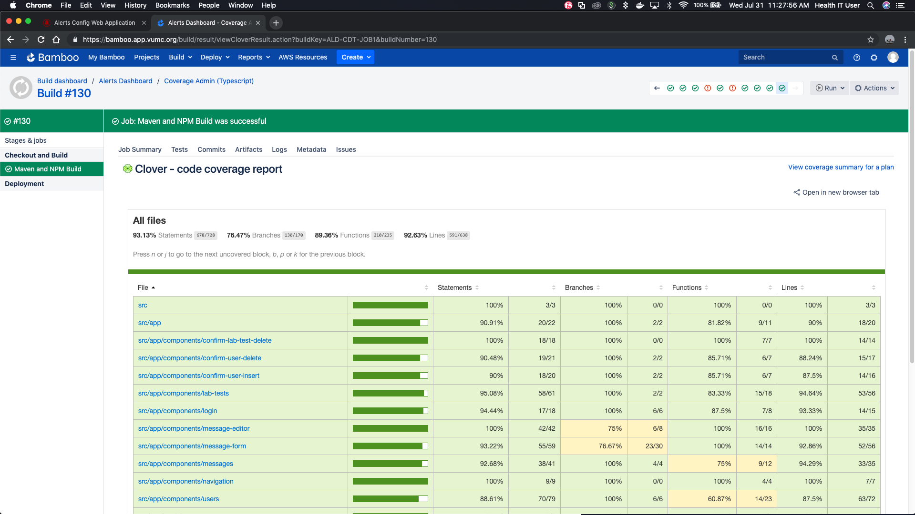
UI typescript:

Slide 16
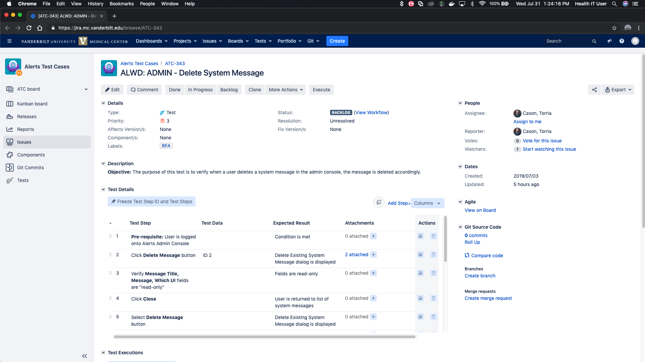
Automate tests generated by QA

Slide 17
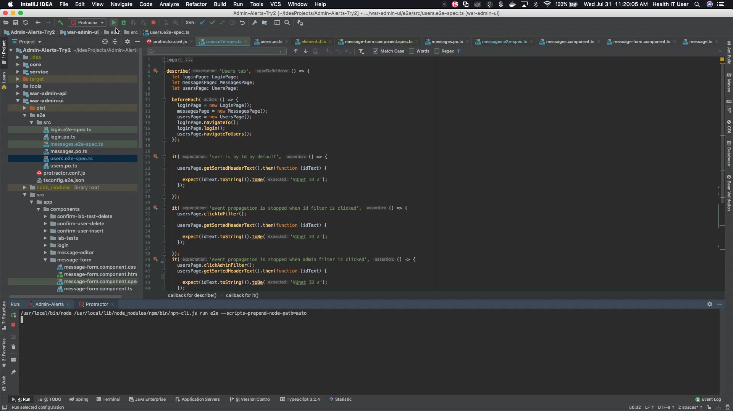
Bonus: Testing with Protractor

